Slide 1
SQL Clause

Slide 2
HAVING Clause in SQL
The HAVING clause places the condition in the groups defined by the GROUP BY clause in the SELECT statement.
This SQL clause is implemented after the 'GROUP BY' clause in the 'SELECT' statement.
This clause is used in SQL because we cannot use the WHERE clause with the SQL aggregate functions. Both WHERE and HAVING clauses are used for filtering the records in SQL queries.

Slide 3
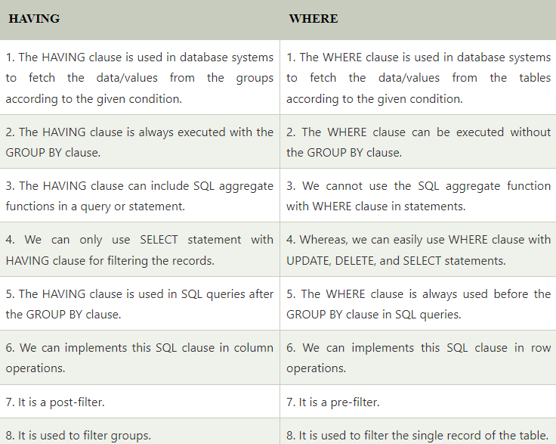

Slide 4
HAVING clause in SQL
The HAVING clause was added to SQL because the WHERE keyword cannot be used with aggregate functions.
SELECT column_name(s) FROM table_name WHERE condition GROUP BY column_name(s) HAVING condition ORDER BY column_name(s);

Slide 5
The following SQL statement lists the number of customers in each country. Only include countries with more than 5 customers:
SELECT COUNT(CustomerID), Country FROM Customers GROUP BY Country HAVING COUNT(CustomerID) > 5;

Slide 6
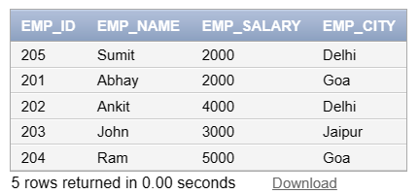
For example: Employee1 table

Slide 7
If you want to add the salary of employees for each city, you have to write the following query:
Select sum(Emp_salary), Emp_city from employee1 GROUP BY Emp_city;

Slide 8
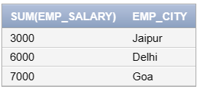
The output of the above query shows the following output:

Slide 9
Now, suppose that you want to show those cities whose total salary of employees is more than 5000. For this case, you have to type the following query with the HAVING clause in SQL:
SELECT SUM(Emp_Salary), Emp_City FROM Employee1 GROUP BY Emp_City HAVING SUM(Emp_Salary)>5000;

Slide 10
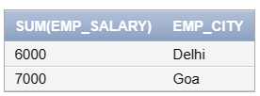
The output of the above SQL query shows the following table in the output:

Slide 11
ORDER BY CLAUSE
The ORDER BY keyword is used to sort the result-set in ascending or descending order.
The ORDER BY keyword sorts the records in ascending order by default.
To sort the records in descending order, use the DESC keyword.

Slide 12
ORDER BY Syntax
Select * from tablename ORDER BY Columnname ASC|DESC;

Slide 13
Examples
select * from orders ORDER BY orderid DESC;
Select * from orders ORDER BY orderid ASC;

